Slide 1










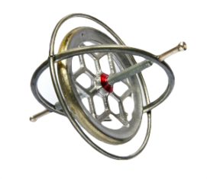




Feature Engineering
Predictive Modelling
Interpretation
Feature Selection
Features
Training Data
Inference
Stay-location Inference
Feature Importance
Data Pre-processing
Multilabel Targets
Testing Data
Evaluation
Stay-location
Sensor Features
Raw
Features
Spatial Features
Stay-location Labels
Feature Extraction
Filtering & Clustering
Motion Sensor Data
Sound Data
WiFi Data
Regional Data
Stay-location Tagging Data
Data Acquisition

